Slide 1

COVID PLANET
Anna Shin
Ingrid Mongori Yondo
Yanis Benneouala

Slide 2
HEALTHCARE
Database that reflects the impact of Covid 19 in the world.
Sources from official organizations and web scrapping.
Data base: 4 tables with several entities.

Slide 3
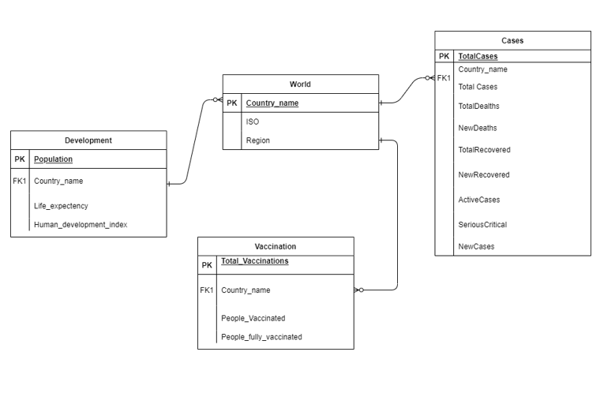
ER

Slide 4
CHALLENGES
Good data sets are not easy to find.
Difficulties to sort out data.
Some websites don’t have public API.
Web scrapping can be difficult on some web pages.
Issues to download CSV files on MySQL.

Slide 5
WEB SCRAPING WITH PYTHON
import pandas as pd
from bs4 import BeautifulSoup
import requests
import dask.dataframe as dd
page = requests.get("https://www.worldometers.info/coronavirus")
# page.content
soup = BeautifulSoup(page.content, 'lxml’)
# print(soup.prettify())
table = soup.find('table', attrs={'id': 'main_table_countries_today'})
rows = table.find_all("tr", attrs={"style": ""})
data = []
for i, item in enumerate(rows):
if i == 0:
data.append(item.text.strip().split("\n")[:13])
else:
data.append(item.text.strip().split("\n")[:12])
# print(data)
df = pd.DataFrame(data)
df.to_csv
# print(df)
ddd = dd.from_pandas(df, npartitions=1)
ddd.head(10)
df.to_csv("/Users/bene/Downloads/df.csv")

Slide 6

QUERIES #1
1 - The country with the most deaths:
SELECT Country_name, max(TotalDeaths)
FROM healthcare.cases;

Slide 7

QUERIES #2
2- Number of people fully vaccinated in Germany:
SELECT Country_name, People_fully_vaccinated FROM healthcare.vaccination
WHERE Country_name = "Germany“;

Slide 8
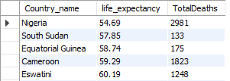
QUERIES #3
3 - Number of deaths for the top 5 countries with low life expectancy:
SELECT Dvlp.Country_name, Dvlp.life_expectancy, cases1.TotalDeaths
FROM healthcare.development Dvlp
LEFT JOIN healthcare.cases cases1
ON Dvlp.Country_name = cases1.Country_name
WHERE SeriousCritical IS NOT NULL
GROUP BY Dvlp.Country_name
ORDER BY Dvlp.life_expectancy ASC;

Slide 9
NORMALIZATION

Slide 10


